Slide 1

SBR-X
Self-Balancing Robot with Line Following & Obstacle Avoidance
Project Showcase • Embedded Systems & Control
Prepared by Frais Asghar
September 2026

Slide 2
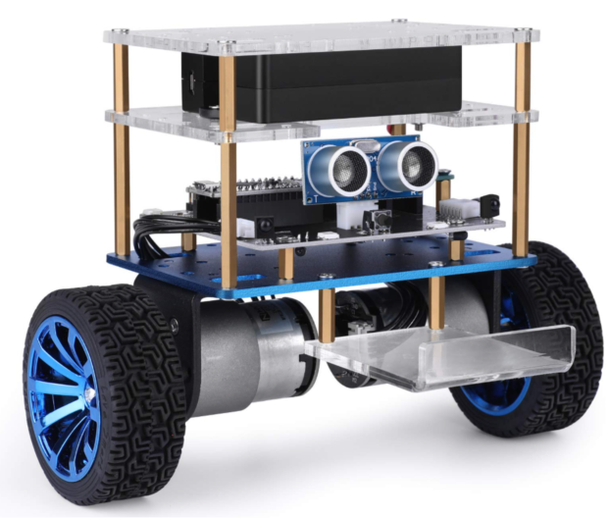
OVERVIEW
What We'll Cover
01
Problem & Objectives
Why SBR-X exists and what it set out to do
02
System Design
Architecture, control loop, and mode logic
03
Hardware
Chassis, components, and wiring
04
Methodology & Results
Sensor fusion, PID tuning, and outcomes
SBR-X Chassis
Battery deck, sensor stage, and dual-wheel drive base
05
Roadmap
What's next for the platform
SBR-X Technical Showcase
2

Slide 3
THE PROBLEM
Balance and Autonomy Rarely Coexist
Two-wheeled robots are naturally unstable and fall without constant correction. Most hobby robots handle only one behavior at a time, either balancing or driving, rarely both together. There was a need for a robot that could stay upright on its own while still reacting to its surroundings.
WITHOUT CORRECTION
A two-wheeled platform falls in under a second once it tips past its recoverable angle.
SBR-X SOLVES THIS BY
2
• Continuous PID correction at a fixed rate
wheels, zero static support
• A fail-safe stop outside recoverable range
3
behaviors needed in one system
• Driving logic that only biases, never overrides, balance
1
microcontroller, no external compute
SBR-X Technical Showcase
3

Slide 4
GOALS
Project Objectives
This project set out to build a robot that balances on its own and still behaves intelligently while moving, combining stable control with real-time sensing in a single compact system.
Sense Tilt
Stay Upright
Follow a Line
Read IMU data and filter it for a stable angle estimate
Build a PID loop that keeps the robot balanced
Track a reflectance line while remaining balanced
Avoid Obstacles
Switch Modes
Run Standalone
Detect and steer around obstacles ahead
Cycle behaviors with a single push button
Keep everything on one microcontroller
SBR-X Technical Showcase
4

Slide 5
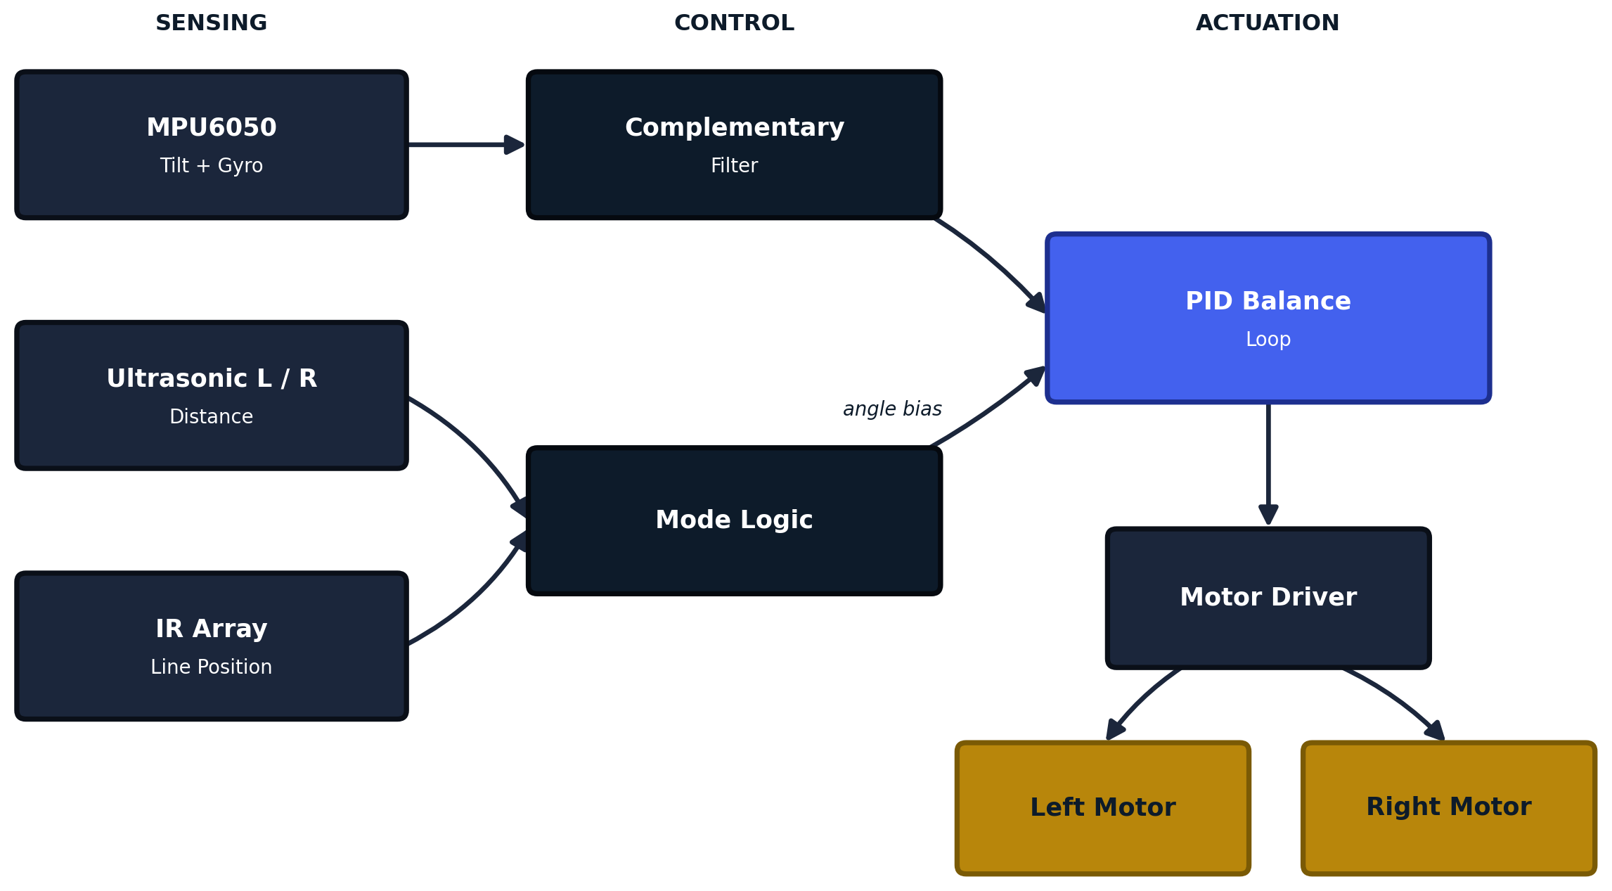
SYSTEM DESIGN
System Architecture
Sensing, control, and actuation form three clear stages. Every actuation command traces back through the same balance loop, so driving behaviors only steer, they never override stability.
Sensing
Control
PID Core
Actuation
SBR-X Technical Showcase
5

Slide 6
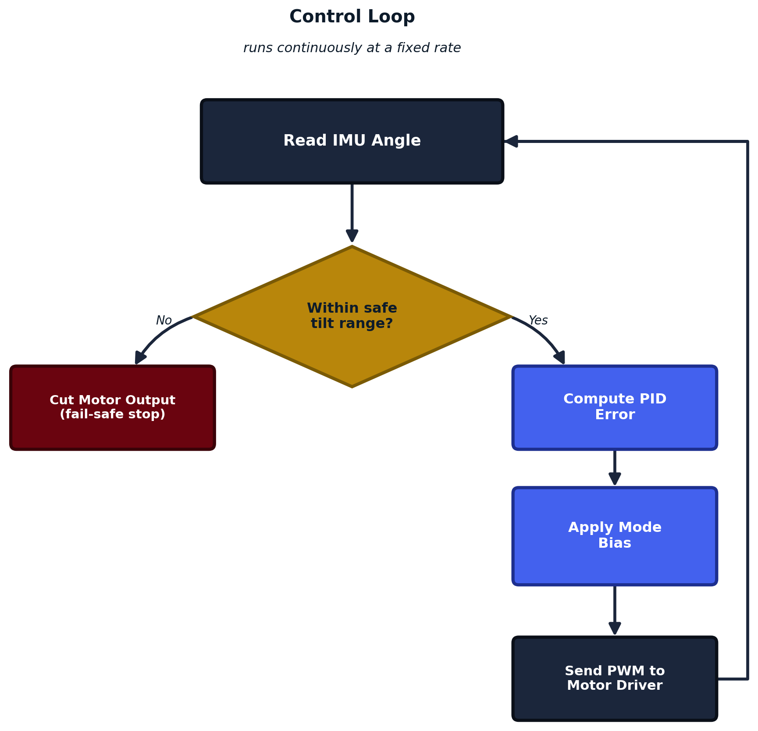
SYSTEM DESIGN
The Balance Control Loop
The loop runs continuously at a fixed rate: read the tilt angle, check it is recoverable, compute a PID correction, apply the active mode's bias, and drive the motors. Out-of-range tilt triggers an immediate fail-safe stop.
1
Read IMU angle
2
Check safe tilt range
3
Compute PID error
4
Apply mode bias
5
Send PWM to motors
SBR-X Technical Showcase
6

Slide 7
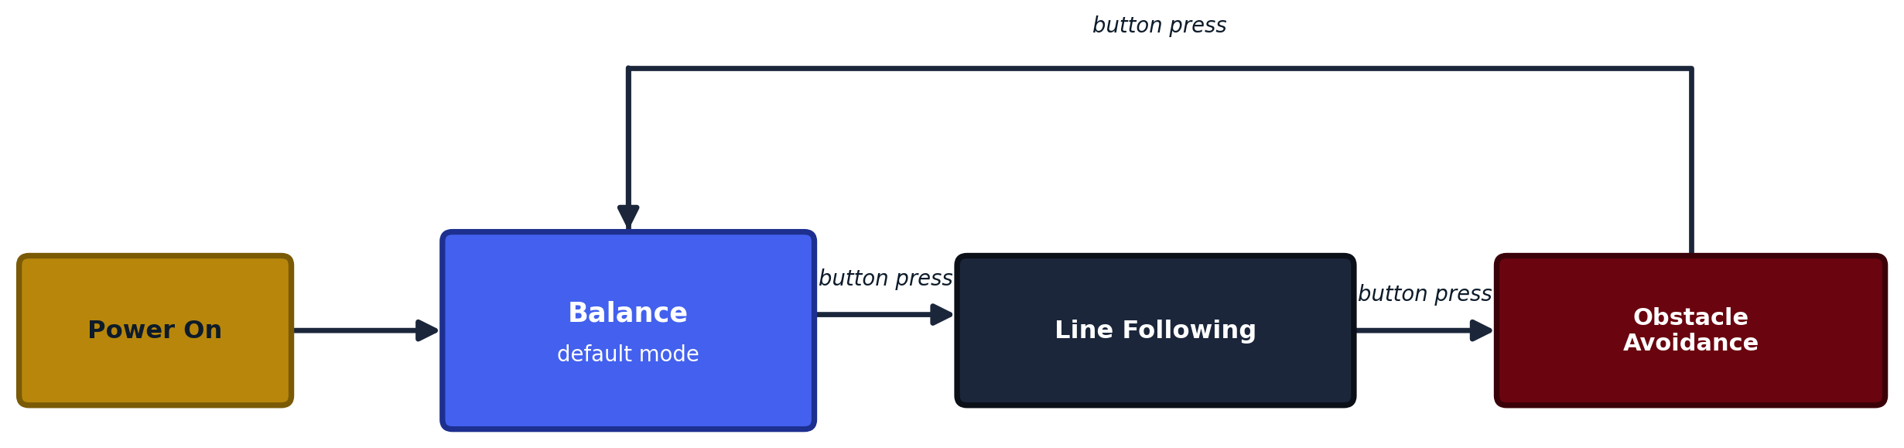
SYSTEM DESIGN
Mode State Machine
A single push button cycles through all three modes. Balance stays active underneath at every stage, the button only changes which behavior biases the lean angle.
Balance
Line Following
Obstacle Avoidance
Default mode. Holds an upright position on two wheels.
Tracks a line using the IR reflectance array.
Steers around obstacles using ultrasonic sensors.
SBR-X Technical Showcase
7

Slide 8
HARDWARE
The SBR-X Chassis
1
Battery Deck
Top tier. Onboard Li-ion power for logic and motors.
2
Sensor & Driver Stage
Middle tier. IMU, ultrasonic sensors, and motor driver.
3
Drive Base
Bottom tier. Dual DC gear motors and wheels.
SBR-X Technical Showcase
8

Slide 9
HARDWARE
Bill of Materials
Part | Role | Qty
Arduino Uno / Nano | Main controller, runs the PID loop and mode logic | 1
MPU6050 (accel + gyro) | Measures tilt angle and angular velocity | 1
Dual ultrasonic sensor module | Forward obstacle detection | 1
IR line sensor array | Line detection for line-following mode | 1
L298N / TB6612FNG driver | Drives both DC motors from PWM signals | 1
DC gear motors with wheels | Drive wheels | 2
Li-ion battery pack | Onboard power for logic and motors | 1
Acrylic chassis | Tiered structural frame for all stages | 1
Mode select push button | Switches between all three modes | 1
Placeholder list based on the pictured build. Update part names and quantities to match your final components.
SBR-X Technical Showcase
9

Slide 10
HARDWARE
Wiring & Pin Map
Signal | Component | Controller Pin
SDA / SCL | MPU6050 | A4 / A5
Trig / Echo (L) | Ultrasonic sensor, left | D2 / D3
Trig / Echo (R) | Ultrasonic sensor, right | D4 / D5
IR array (analog) | Line sensor | A0 to A3
IN1 to IN4 | Motor driver | D6 to D9
ENA / ENB | Motor driver (PWM speed) | D10 / D11
Mode button | Push button | D12
WHY IT'S LAYERED THIS WAY
Sensors feed the mode logic, never the motors directly. Every pin ultimately routes through the PID loop, so a wiring or sensor fault can be caught by the fail-safe stop instead of driving the motors blind.
Placeholders, replace with the actual wiring once finalized.
SBR-X Technical Showcase
10

Slide 11
METHODOLOGY
How the Control System Works
1
2
3
Sensor Fusion
PID Control
Mode Logic
A complementary filter blends the gyroscope's fast, drifting angle with the accelerometer's slow, drift-free angle into one stable tilt estimate.
Proportional, integral, and derivative terms turn the tilt error into a motor correction that settles quickly instead of oscillating or drifting.
Line offset or obstacle distance is converted into a small bias on the PID target, so driving never bypasses the balance loop.
SBR-X Technical Showcase
11

Slide 12
RESULTS
Illustrative PID Step Response
Conceptual step response: after a disturbance, a well-tuned PID loop brings the tilt angle back within a tolerance band and holds it there. Replace with logged sensor data once test runs are recorded.
SBR-X Technical Showcase
12

Slide 13
RESULTS
Observed Behavior
Stable Balance
Holds position through idle, line following, and obstacle avoidance.
TEST FOCUS AREAS
• Max tilt deviation while holding balance
Accurate Line Tracking
Follows a line reliably using the IR reflectance array.
• Recovery time from a push disturbance
Reliable Obstacle Steering
Detects and steers around obstacles via ultrasonic sensing.
• Line-track completion rate
• Obstacle detection range
Instant Mode Switching
Responds to each button press without dropping balance.
• Mode-switch response time
Fully Standalone
Runs entirely on the microcontroller, no external computer.
SBR-X Technical Showcase
13

Slide 14
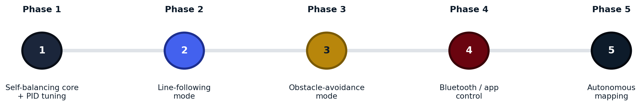
WHAT'S NEXT
Development Roadmap
Phase 1
Phase 2
Phase 3
Phase 4
Phase 5
Self-balancing core and PID tuning
Line-following mode
Obstacle-avoidance mode
Bluetooth / app control
Autonomous mapping
SBR-X Technical Showcase
14

Slide 15
Thank You
SBR-X shows that a single microcontroller can balance a two-wheeled robot in real time while still running autonomous driving behaviors on top of that balance loop.
Frais Asghar
github.com/fraisasghar

